Slide 1
pre-project Presentation DC Wallet: Decentralized Cryptocurrency wallet Program: B. Tech in CSE
Mentor : Dr. Mohan
Group No. : 01
Team Leader : Suraj Sharma
Department : Computer Science & Engineering

Slide 2
Project Team
Sl. no.​ | Registration no.​ | Students​
1​ | 18ETCS002126​ | SURAJ SHARMA​
2​ | 18ETCS002407​ | SHASHANK PANDEY​
3​ | ​18ETCS002137 | ​V MANIKANTA
4​ | 18ETCS002073 | MISSILE GURUNG

Slide 3
Outline
Title and Aim
Objectives
Methods and Methodology ( or Block Diagram)
Results(Optional)
Cost Estimation
Gantt Chart
References

Slide 4
TITLE DC Wallet: Decentralized Cryptocurrency wallet
AIM
To Implement a Real-Time decentralized cryptocurrency wallet application with Web3.0 Technology and Ethereum blockchain.

Slide 5
Objectives
1. To conduct a literature survey on the existing cryptocurrency wallets
applications. 2. To acquire functional and non-functional requirements based on the
literature survey.
3. To implement and test a system for wallet application. 4. To perform project report writing and documentation.

Slide 6
Methods and Methodology
To conduct a literature survey on the existing technology on crypto currency wallets:
1.1 Literature review on cryptocurrency exchange systems will be carried out
by referring reputed journals, books, manuals, related Documents.
1.2 Identify the gaps in already existing systems and attempt to
improve the performance of the system.

Slide 7
Methods and Methodology
2. To acquire functional and non-functional requirements based on
the literature survey:
2.1 On conducting literature survey, the functional and non-
functional requirements are obtained.
2.2 Based on the identified requirements, a high-level design will
be created in UML.

Slide 8
Methods and Methodology
3. To implement and test the Wallet Application (Block Diagram):
User interface for wallet
Application
Connecting to our wallet containing Ethereum Faucets
Setting up the test Server for our wallet Application
React JS(HTML,CSS,JS) is used for creating UI
Connecting to Meta
Mask for accessing our Ethereum faucets
Alcheney is used for creating & setting up our test-servers
Creating and Deploying the smart contract on
Ethereum test Network
Getting the past transaction records from our Ethereum test network
Web 3.0 provider is used to request all the past transaction details from the Ethereum blockchain
Solidity used for coding the smart contract & deploying the smart contact on the network

Slide 9
Methods and Methodology
4. To perform project report writing and documentation:
4.1 Develop a detailed project report as per the template
Specified.
4.2 Display and demonstrate in university organized project
exhibition and demonstrations.

Slide 10
LITERATURE SURVEY
Sl No. | Author | Name and year of publication | Research focus | Techniques and Technologies | Conclusion
01. | Dejan Vujičić, Dijana Jagodić, Siniša Ranđić | [1] Blockchain Technology, Bitcoin, and Ethereum: A Brief Overview, ,2019 | The objective of the project is to provide an early development and ideas on Decentralized Digital Currencies how it evolves and grow into such large scale. | The Web of Science database has been selected, and the analyses performed allowed us to identify five research trends obtained from the bibliographic coupling analysis: (1) Understanding consumer's (non)acceptance of cryptocurrencies (2) Ethical aspects and trust in cryptocurrencies, | Bitcoin and Ethereum today are the most known and valuable cryptocurrencies. They are based on blockchain technology that is intended to promote a trust mechanism in a peer-to-peer network based on the consensus of the majority of the nodes.

Slide 11
LITERATURE SURVEY
02. | Abderahman Rejeb, Karim Rejeb2, John G. Keogh | [2] Crypto- curren- cies in Modern Finance | The focus is on crypto- currencies in the finance and banking sectors is gaining momentum. | (3) Blockchain technology as a trust-free technology, (4) The blockchain/trust economy (5) Blockchain technology: challenging trust. Method done in this literature review is using different academic databases, such as Google Scholar, Scopus, Web of Science and Springer Link. | In the past few numerous cryptocurrencies, hashing algorithms, and consensus agreements in the networks. Some of the cryptocurrencies worth mentioning are Ripple, Cardano, NEO, Stellar, Litecoin, EOS, IOTA and many more. In this paper, we have synthesized the literature on the role and challenges of cryptocurrencies in modern business and financial systems.

Slide 12
LITERATURE SURVEY
SL No. | Author | Name and year of publication | Research focus | Techniques and technologies | Conclusion
03. | Saeed Alzahrani, Portland State University Tugrul Daim, Portland State University | [3] Analysis of the Cryptocurrency Adoption Decision on year 2019 | The goal is to offer a currency that is not tied, created or backed by a government. Cryptocurrency use the block chain technology. Cryptocurrency adoption level has increased, and the market has grown dramatically. The aim of this paper is to fill the gap in the current literature by investigating the current cryptocurrency. | Cryptocurrency adoption level is used in this literature survey. Adoption level includes Recognition of increased cryptocurrency using indicators. The main goal is to classify the existing adoption level. The blockchain wallet is used in this method. | The goal of this paper is to investigate the cryptocurrency adoption decision. We examined the factor influencing the adoption decision and provided an in-depth analysis of each factor.

Slide 13
LITERATURE SURVEY
Sl. No. | Author | Name and year of publication | Research focus | Techniques and technologies | Conclusion
04. | Shamili Prabakaran and B. Muruganantham | [4] Enhancing the Decentralized Application (Dapp) for E-commerce by Using the Ethereum Blockchain. 1 January 2022 | Research mainly focuses on building the blockchain based based decentralized application by using the web3 library along with the ganche and metamask in the local host. To secure the online shopping transactions upon the user’s privacy concern. | For the front end they used web3 to interact with smart contract and React.js for the client-side UI. For the wallet they have used MetaMask for managing personal accounts and private keys. For developing framework for smart contracts they used Truffle as a back-end. | We conclude that, the implementation of the Dapp could done with the other test networks also for the efficient working of the nodes and the performance of the nodes with different test networks can be analysed in future work.

Slide 14
LITERATURE SURVEY
SL No. | Author | Name and year of publication | Research focus | Techniques and technologies | Conclusion
 |  |  |  | Ganache- Local private network for smart contracts development. Test net- Public test networks for smart contracts development before deploying to the main network. Main Network- Public networks for actual smart contracts development. | Also, the quantum computing under blockchain is the current research for high computational power and to mine the mathematical crypto puzzle easily in future work.

Slide 15
LITERATURE SURVEY
Sl. No. | Author | Name and year of publication | Research focus | Techniques and technologies | Conclusion
05. | Sandeep Kumar Panda and Suresh Chandra Satapathy | [5] An Investigation into Smart Contract Deployment on Ethereum Platform Using Web3.js and Solidity Using Blockchain May 2021 | Here in this paper they mainly focus on the consensus algorithms that are used to manage and control blocks on the blockchain. Also on the Ethereum which is used to implement Dapp using smart contracts. Lately focuses on the implementation methodology on Ethereum blockchain for creating and deploying and also interaction with the smart contract. | For the front end they used web3 to interact with Ethereum smart contract. MetaMask is used as Ethereum client for managing personal accounts and private keys. The smart contract was deployed on Rinkeby Test network. For developing framework for smart contracts they used Truffle as a back-end. Ganache- Local private network for smart contracts development. | We conclude that addressing the fundamentals of the visionary blockchain technology to develop, discussed on the consensus algorithms. Proposed a novel approach for deploying smart contract and interacting with it. Also explore the unexplored areas related to Ethereum, smart contract and Web3.

Slide 16
Functional and Non-Functional Requirement
Functional Requirements: | Requirement Statement:
FR1 | The application should allow user to connect with their Ethereum blockchain which stores the Ethers(Type of Ethereum Cryptocurrency ).
FR2 | The application should allow the user to login using credential In The MetaMask.
FR3 | The application should allow the user to see balance in the Ethereum Account.
FR4 | The application should allow to send cryptocurrency to their friend’s wallet address, and receive cryptocurrency on their wallets also.
FR5 | User should have an option to send a text attached to the transaction so that the receiver may find it easier to recognize from whom he has received the cryptocurrency.
FR6 | User should be able to send Gif attachments along with the transaction message so that the wallet looks attractive.
FR7 | All the transactions taking place in the user's wallet must be reflected in the Ethereum Blockchain.

Slide 17
Functional and Non-Functional Requirement
Non-Functional Requirements: | Requirement Statement
NFR1 | The application should be able to provide transaction services to multiple users at any given time
NFR2 | Messages and transaction shared between users should be End-to-End encrypted to maintain privacy.
NFR3 | Application must be lightweight and process the transaction instantaneously, also Application must be accessible from many browsers as a web application.
NFR4 | The application may be expanded to support different cryptocurrency transactions

Slide 18
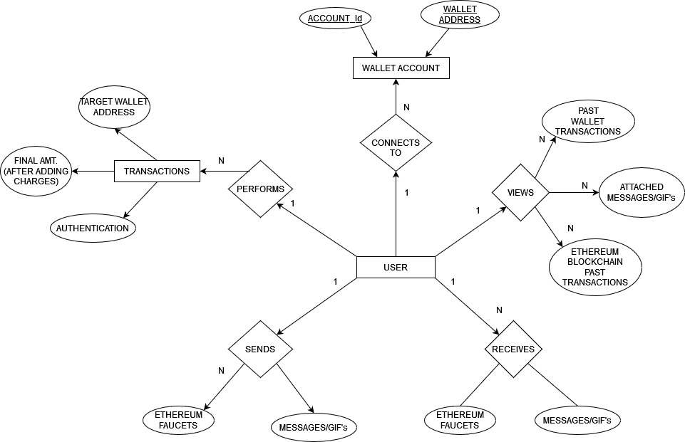
Entity Relation Diagram

Slide 19
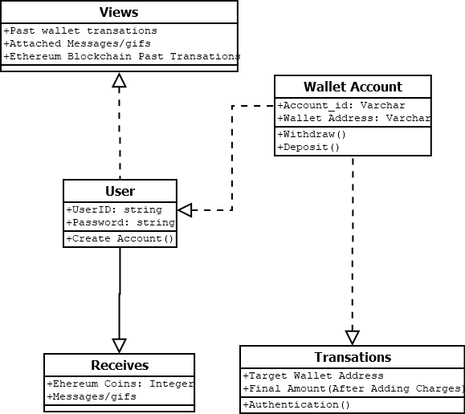
Class Diagram

Slide 20
Working of The Wallet Application:
Start.
2. Connect to MetaMask:
if account present do:
Login
else do:
write create Account.
3. Enter R_Add, Amt, Message, Gif and click send button;
4. T_Fee := G_Units + (B_Fee + tip);
Final_Amt := Amt + T_Fee;
5. Check the wallet balance:
if Wallet Balance < Final_Amt do:
write Error ;
else do: proceed ;
5. Authenticate the Transaction In the MetaMask;
6. Store the Transaction on the Test-Server Address and on Ethereum Blockchain;
Show past transactions on the Wallet User Interface := S_Add, R_Add, Message and Gif;
8. End.
Keywords:
1. R_Add : Receiver’s Address.
2. S_Add : Sender’s Address.
3. Amt: Amount to be sent.
T_Fee: Charges incurred on
the transaction.
5. G_Units: Ethereum gas charges for
the Transaction.
B_Fee: Base Fees of the Ethereum
Blockchain.
7. Final_Amt: Amount after adding all
the charges as per the
Transaction Amount.

Slide 21
Code Implementation
Code Implementation can be found on the following GitHub Repository :

Slide 22
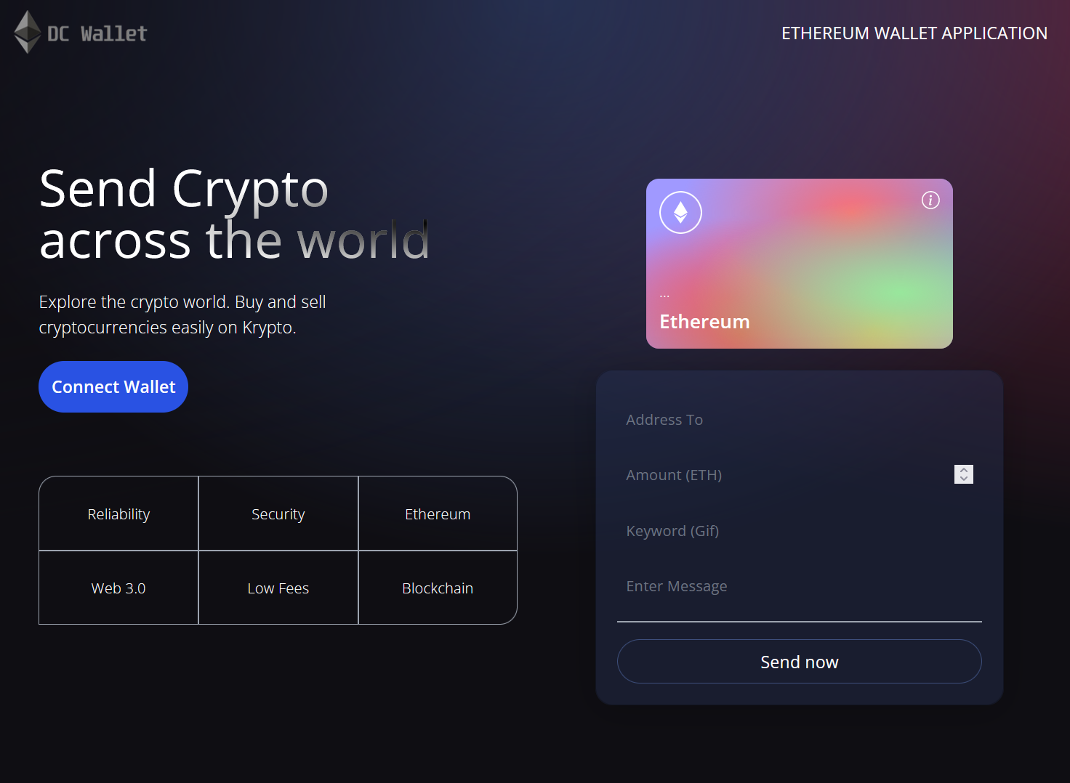
Results
Fig 1 : Shows the User Interface for the wallet application

Slide 23
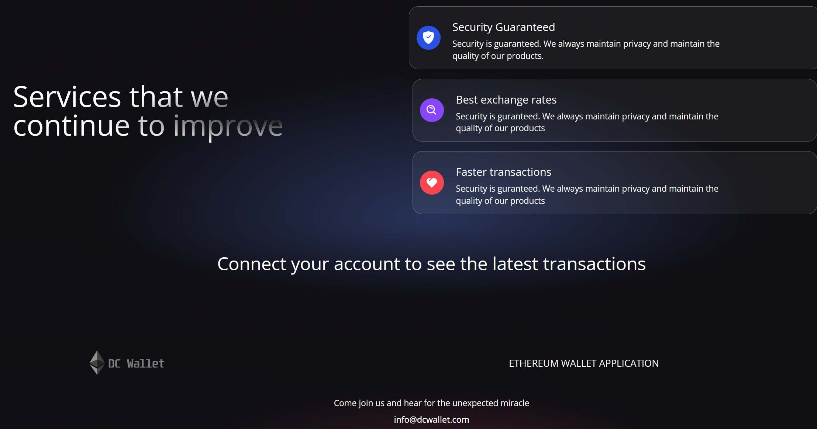
Results
Fig 2 : Shows the User Interface for the wallet application

Slide 24
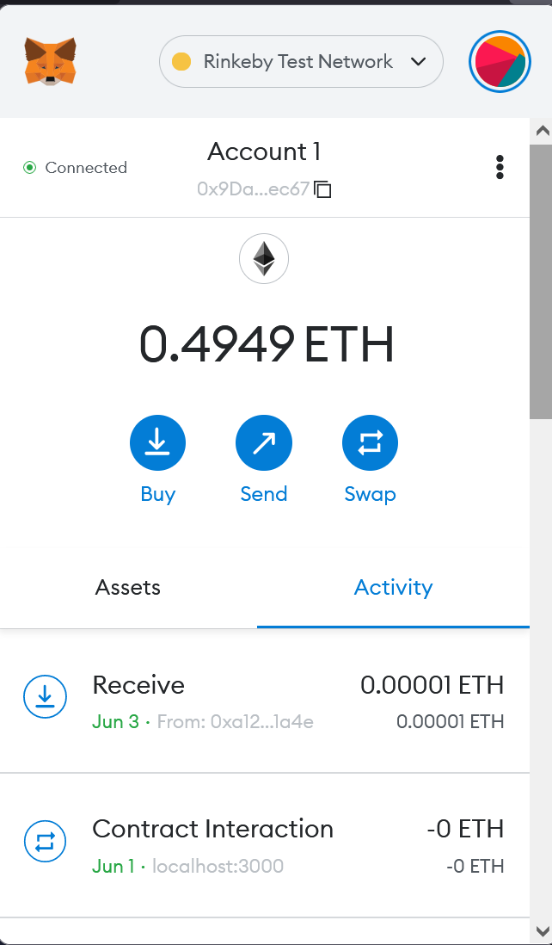
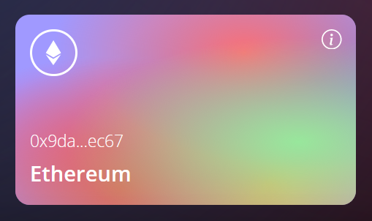
Results
Fig 3 : Shows the MetaMask Connected for the wallet application
and the Address on the Ethereum Card

Slide 25
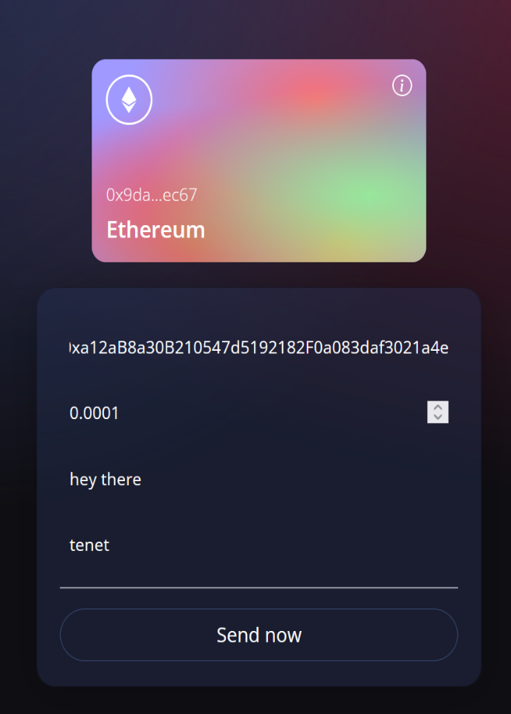
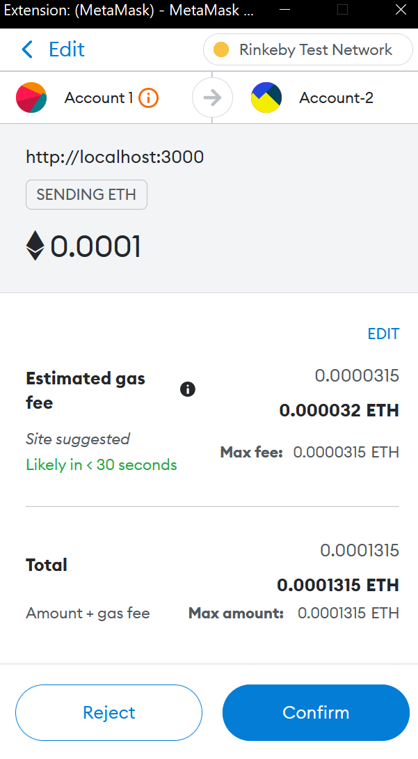
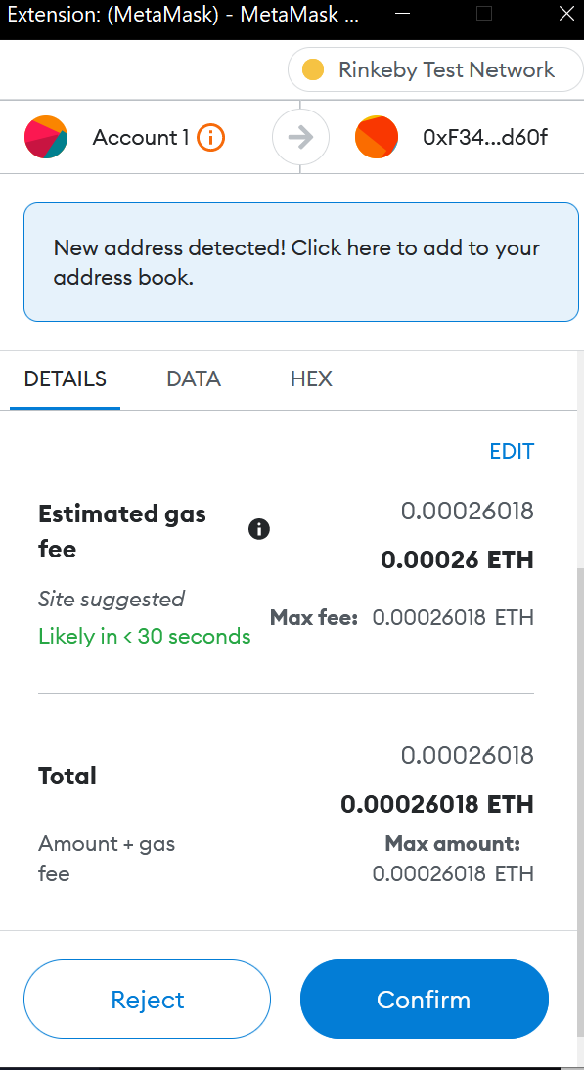
Results
Fig 4 : Shows the Transactions Being made through the wallet application
on Ethereum Blockchain.

Slide 26
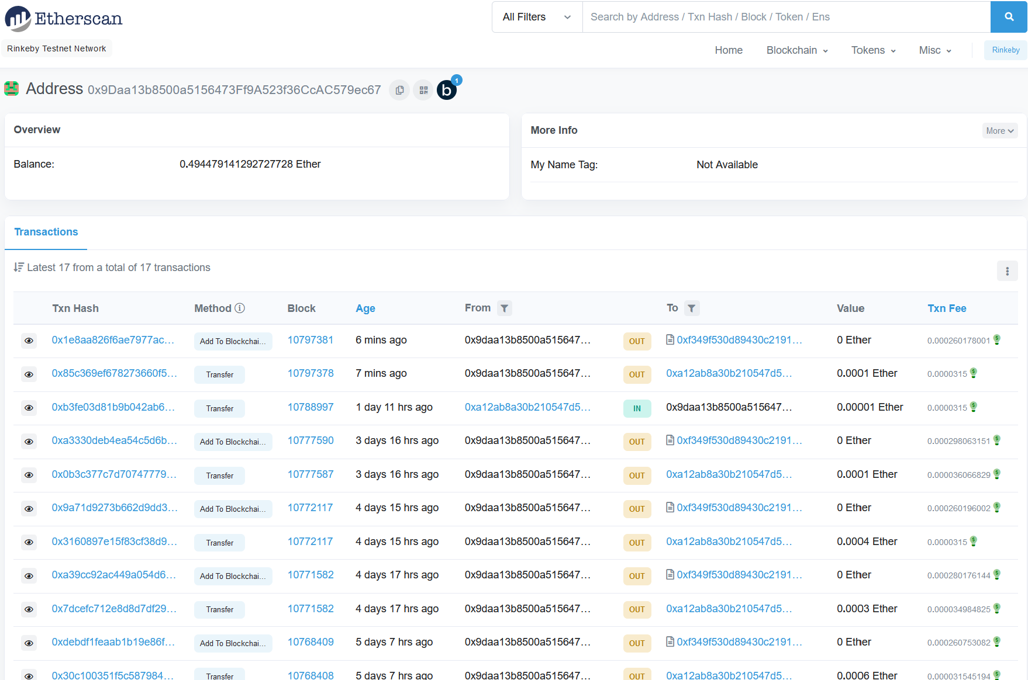
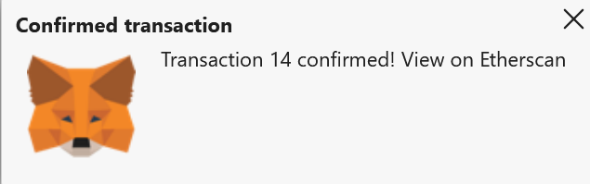
Results
Fig 5 : Shows the Transaction confirmation on MetaMask and Storing the
Transaction on the Ethereum Blockchain.

Slide 27
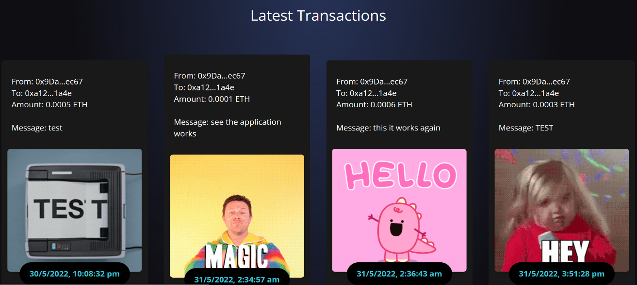
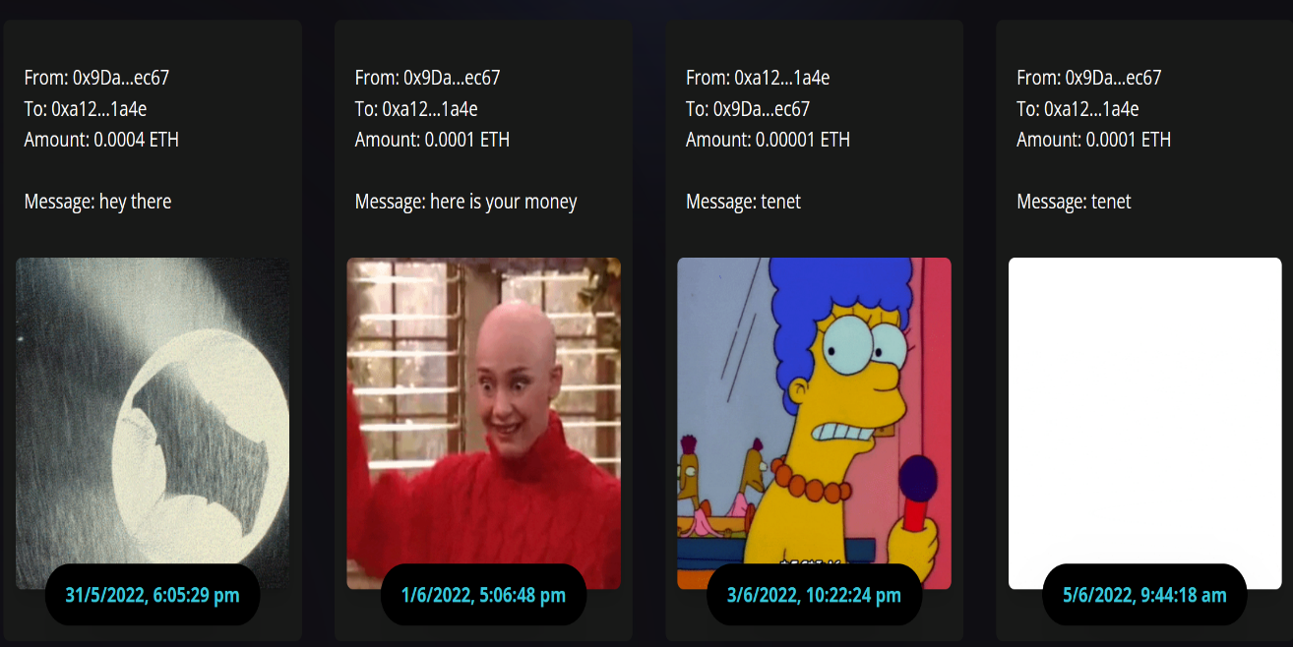
Results
Fig 3 : Shows the Transactions made from the wallet application with date, time, Address of
both Sender and Receiver and Gif’s/Attached Message in the transactions.

Slide 28
Cost Estimation
Man hours:
Man hours per week (students):8 *4 students =32
Man hours per week (faculty): 3

Slide 29
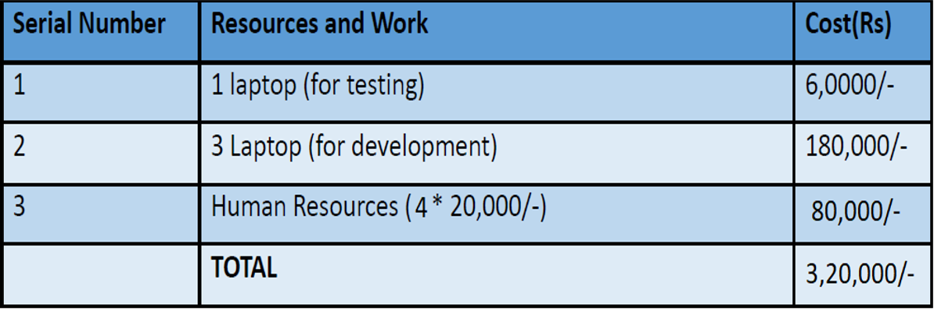
Cost Estimation

Slide 30
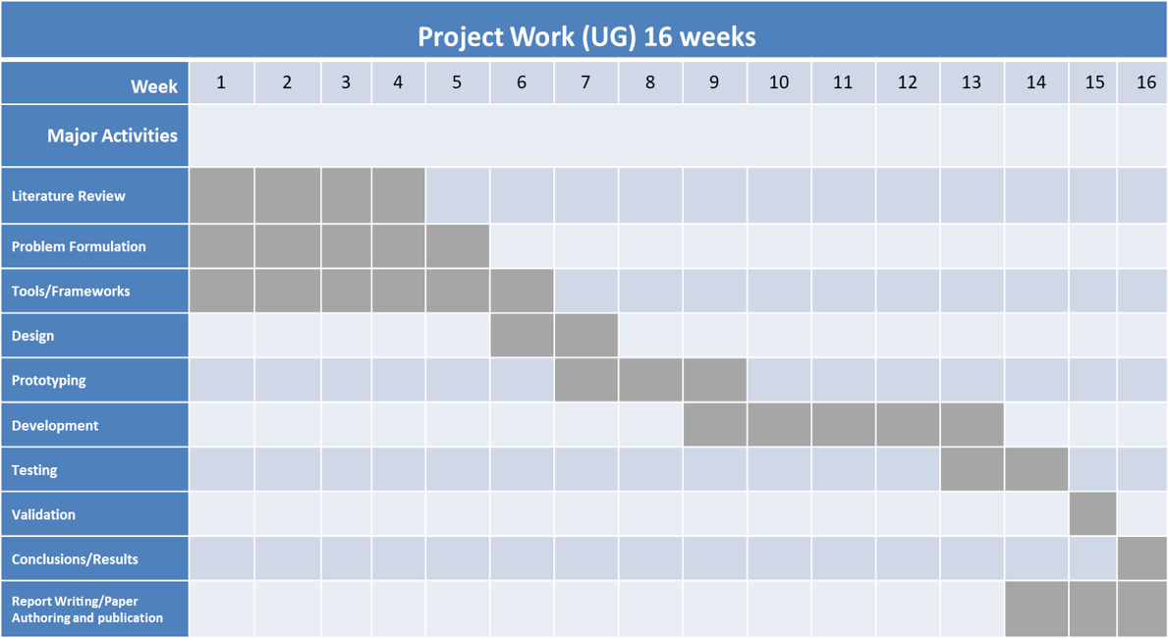
Updated Gantt Chart

Slide 31
References
[1] “Enhancing the Decentralized Application (Dapp)for E-commerce by using the Ethereum Blockchain”.
–by: P.Shamili and Dr.B.Muruganantham, SRM Institute of Science and Technology, Department of
Engineering and Technology, Kattankulathur, Chennai.
[2] “Blockchain technology, bitcoin, and Ethereum: A brief overview”.
–by: Dejan Vujičić, Dijana Jagodić, Siniša RanđićFaculty of Technical Sciences in Čačak University of
KragujevacČačak, Serbia.
[3] “An Investigation into Smart Contract Deployment on Ethereum Platform Using Web3.js and Solidity
Using Blockchain”
–by: Sandeep Kumar Panda and Suresh Chandra Satapathy.
[4] “Survey on Blockchain-Based Smart Contracts: Technical Aspects and Future Research”.
–by: Tharaka Mawanane Hewa1, (Student Member, IEEE), Yining Hu2, (Student Member,
IEEE),Madhusanka Liyanage3, (Senior Member, IEEE), Salil Kanhare4, (Senior Member, IEEE)
and Mika Ylianttila 5, (Senior Member, IEEE) (PDF) Survey on Blockchain-Based Smart Contracts:
Technical Aspects and Future Research.
[5] “Decentralized apps of the future implementing Web3.”
–by: Aditya Patil , Prof. Santosh S (Computer Science and Engineering, Jain(Deemed to be University))

Slide 32
References
6. https://imaginovation.net/blog/crypto-wallet-app-development-guide/
"DECENTRALIZED WALLET APPLICATION (Dapp wallet) ".
7. "Building Blockchain Projects: Building decentralized Blockchain applications with
Ethereum and Solidity "
by Narayan Prusty (Author).
8. https://docs.soliditylang.org/en/v0.8.14/
“Solidity Language documentation”.
9. https://reactjs.org/docs/getting-started.html​
“React JS official documentation”,
10. https://www.dappuniversity.com/articles/how-to-build-a-blockchain-app
“Building a Blockchain application”.

Slide 33
Thank You

